Slide 1

Project EDA Nifty-50 Company (Auto-Sector)
Ashish yadav

Slide 2
EDA by INDUSTRY
AUTOMOBILE
Company Names
HEROMOTOCO
M&M
MARUTI
TATAMOTORS
EICHERMOT
BAJAJ-AUTO

Slide 3
Data Understanding
Hero MotoCorp Ltd.
Data set contain 5306 rows and 15 columns
Treads columns contains null values in 2850 rows
Deliverable Volume columns contain 502 and %Deliverable columns contain 502 null values
Series attribute have one unique value EQ
Symbol attribute contain two unique value ‘ HEROHONDA’ and ‘ HEROMOTOCO’
Min date is 2000-01-03 and Max date is 2021-04-03
Mahindra & Mahindra Ltd.
Data set contain 5306 rows and 15 columns
Treads columns contains null values in 2850 rows
Deliverable Volume columns contain 502 and %Deliverable columns contain 502 null values
Series attribute have one unique value EQ
Symbol attribute contain one unique value ‘ M&M
Min date is 2000-01-03 and Max date is 2021-04-03

Slide 4
Data Understanding
Maruti Suzuki India Ltd.
Data set contain 4427 rows and 15 columns
Treads columns contains null values in 1971 rows
Deliverable Volume columns contain 1 and %Deliverable columns contain 1 null values
Series attribute have one unique value EQ
Symbol attribute contain one unique value ‘ MARUTI’
Min date is 2003-07-09 and Max date is 2021-04-30
Tata Moters Ltd.
Data set contain 5306 rows and 15 columns
Treads columns contains null values in 2850 rows
Deliverable Volume columns contain 514 and %Deliverable columns contain 514 null values
Series attribute have one unique value EQ
Symbol attribute contain two unique value ‘ TELCO’ and ‘TATAMOTORS’
Min date is 2000-01-03 and Max date is 2021-04-03

Slide 5
Data Understanding
Eicher Motors Ltd.
Data set contain 5301 rows and 15 columns
Treads columns contains null values in 2845 rows
Deliverable Volume columns contain 504 and %Deliverable columns contain 504 null values
Series attribute have one unique value EQ
Symbol attribute contain one unique value ‘ EICHER’
Min date is 2000-01-03 and Max date is 2021-04-30
Bajaj Auto Ltd.
Data set contain 3202 rows and 15 columns
Treads columns contains null values in 746 rows
Deliverable Volume columns contain 514 and %Deliverable columns contain 514 null values
Series attribute have one unique value EQ
Symbol attribute contain two unique value ‘ TELCO’ and ‘TATAMOTORS’
Min date is 2000-01-03 and Max date is 2021-04-03

Slide 6
Attribute Understanding
Open: The price at which a stock first trades upon the opening of an exchange on a trading day.
High: The highest price a stock reaches during a trading day.
Low: The lowest price a stock reaches during a trading day.
Last: The last traded price of a stock during a trading day.
Close: The closing price of a stock at the end of a trading day.
VWAP: The Volume Weighted Average Price of a stock, calculated as the sum of the traded price multiplied by the volume, divided by the total volume traded during a trading day.
Date: The date of the trading day.
Symbol: The stock symbol or ticker representing the company.
Volume: The number of shares traded in a stock during a trading day.
Turnover: The total amount of money exchanged during a trading day for a particular stock.
Trades: The number of trades executed for a stock during a trading day.
Deliverable Volume: The number of shares of a stock that are delivered and settled in a trading day.
%Deliverable: The percentage of outstanding shares of a stock that are eligible to be delivered and settled in a trading day.

Slide 7
Data Pre-processing
Common Pre-processing Steps -
Calculating intra day volume of stocks by year
firstly we will convert int to float because volume represent int data type
Then we used intra day formula to get data and appended into data set
Intra day = Volume - Deliverable Volume
As we know that date column contain object ,Firstly we converted object to datetime series
and extract all data of date column into day , month, and year
Append day , month and year as attribute in data set
Check for any duplicate in date columns

Slide 8

Q&A
Stocks performance by avg closing stocks?
Comparing between high , low and volume traded in 2019?
Comparing between volume and turnover in 2019?
What is yearly average turnover of the company?
Relation between Avg Volume of stocks and highest volume of stock in each year and min volume ?
Stocks performance by avg closing stocks?
Top Companies in each sector based on their ?
Impact of COVID19 to the market in 2020 ?
Calculate Intra Day volume in 2019 ?
VWAP is Volume weighted average price calculation in 2020 ?

Slide 9
1
Hero MotoCorp Ltd.

Slide 10
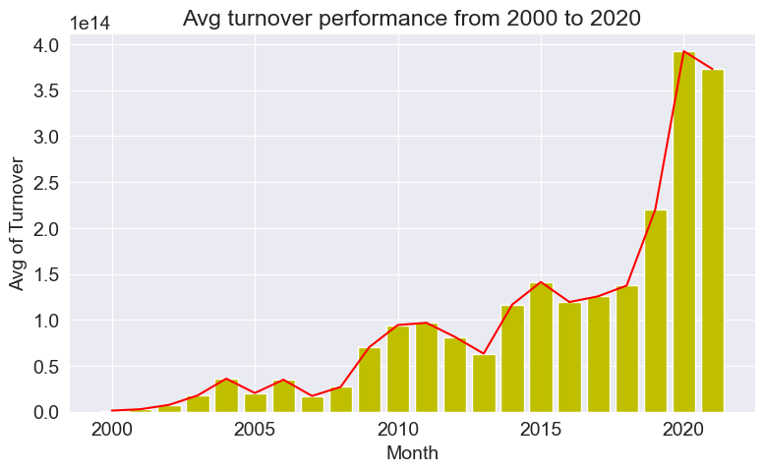
Turn over performance from 2000 t0 2021
In the graph we can relate that turnover is
encressing by year
The Turnover column provides information about the total amount of money exchanged during a trading day , which can be used to calculate the growth rate of a company

Slide 11
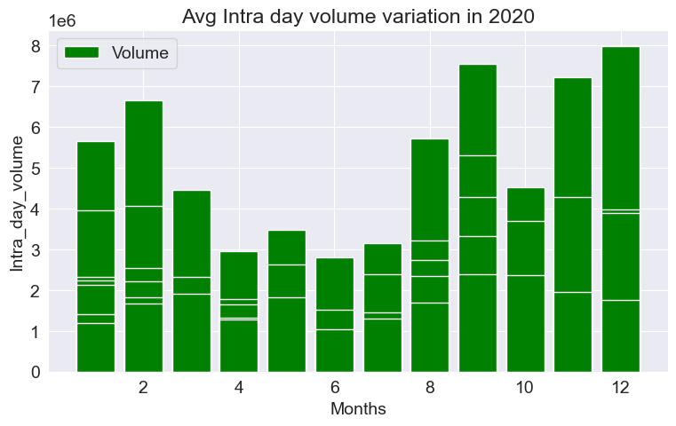
Intra Day volume in 2020
As per the graph volume decrease in between April to august
Impact of covid on stocks volume we can easly identify

Slide 12
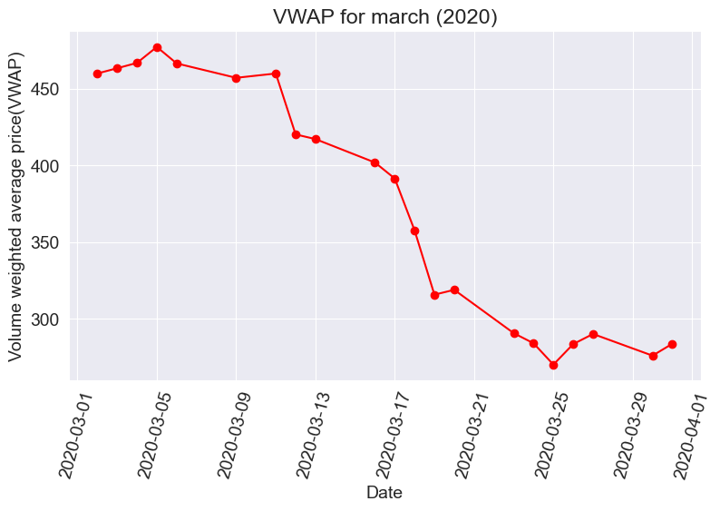
VWAP in 2020
As per graph prices are falling in 2020
If the share on a day is bought below the VWAP on a day, it can be termed as a good buy.Hence this helps in deciding whether to buy the stock or not on a particular day Let us analyze the VWAP attribute from the table let's supose in covid setuation which day was to buy stocks
the VWAP column provides a weighted average price of a stock, which can be used to determine the market sentiment towards a particular stock.

Slide 13
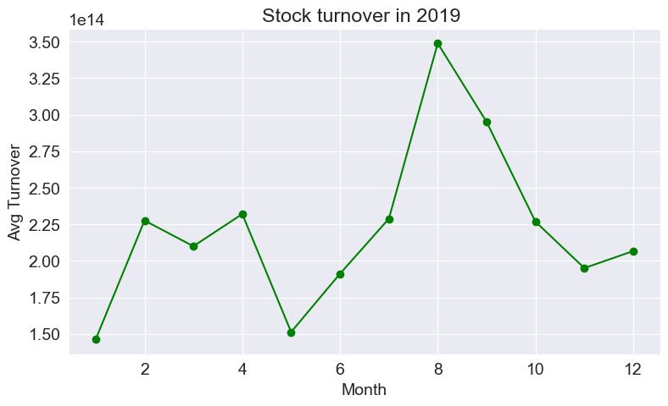
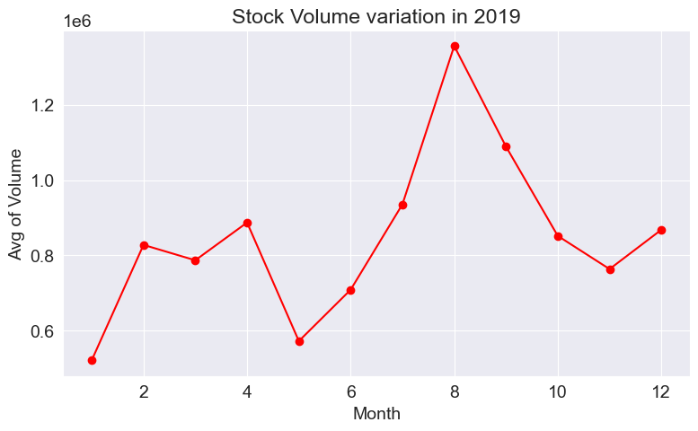
Turnover and volume performance in 2019
As per graph we can say that volume and turnover are co-relational
In between august and setember the volume and turnover was high
Volume columns, one can determine the overall performance of a stock and its popularity among traders

Slide 14
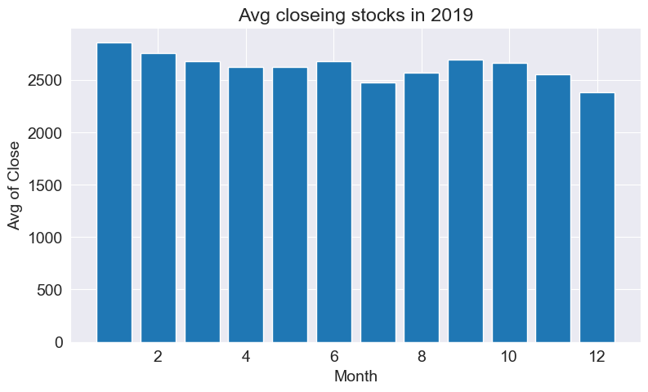
Closeing of stocks in 2019
As per graph we can say that avg closing of stocks in 2019 are normal
Avg close of stocks are laying between 2500 to 3000
Close columns, one can determine the overall performance of a stock and its popularity among traders

Slide 15
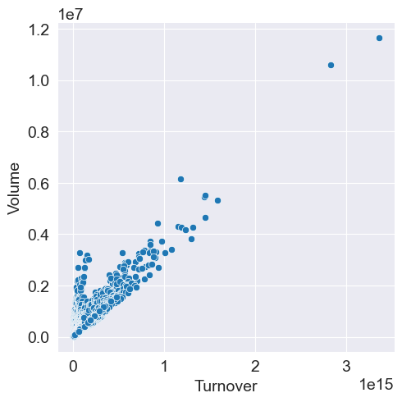
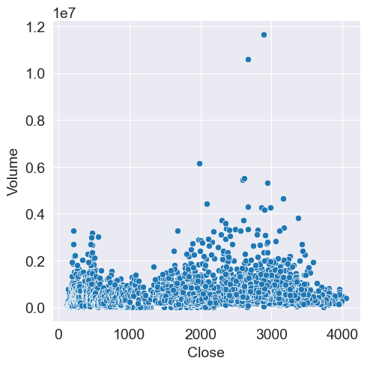
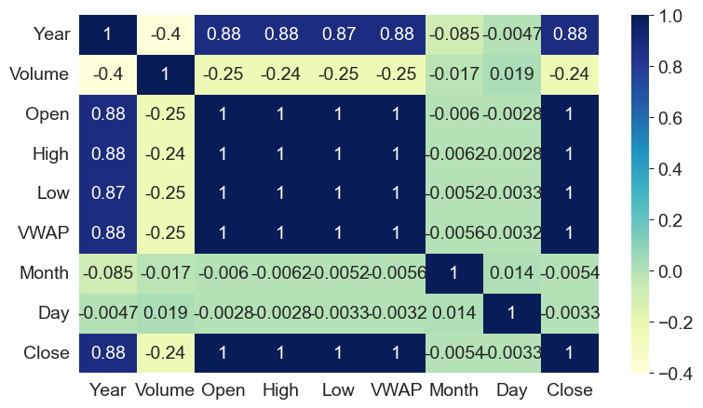
Co -Relation

Slide 16
Conclusion
the Nifty 50 each company data set from 2000 to 2020 provides a wealth of information about the performance of stocks in the Nifty 50 index.
The data includes various columns such as Open, High, Low, Last, Close, VWAP, Date, Symbol, Volume, Turnover, Trades, Deliverable Volume, and %Deliverable. These columns provide valuable insights into the price movements and trading activity of each stock.
Exploratory Data Analysis (EDA) of this dataset can help to identify trends and patterns in the data. For example, by analyzing the Close and Volume columns, one can determine the overall performance of a stock and its popularity among traders
The Turnover column provides information about the total amount of money exchanged during a trading day, which can be used to calculate the growth rate of a company.
Additionally, the VWAP column provides a weighted average price of a stock, which can be used to determine the market sentiment towards a particular stock.
In summary, the Nifty 50 each company data set provides a wealth of information that can be used to gain a better understanding of the performance and trends of stocks in the Nifty 50 index.

Slide 17
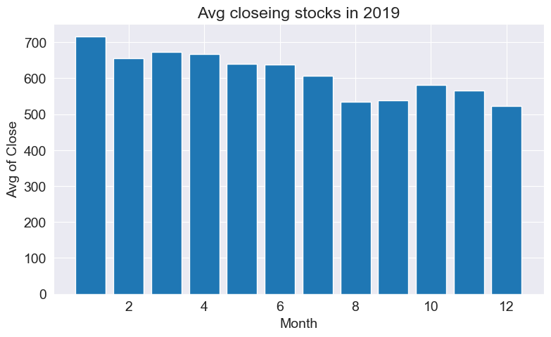
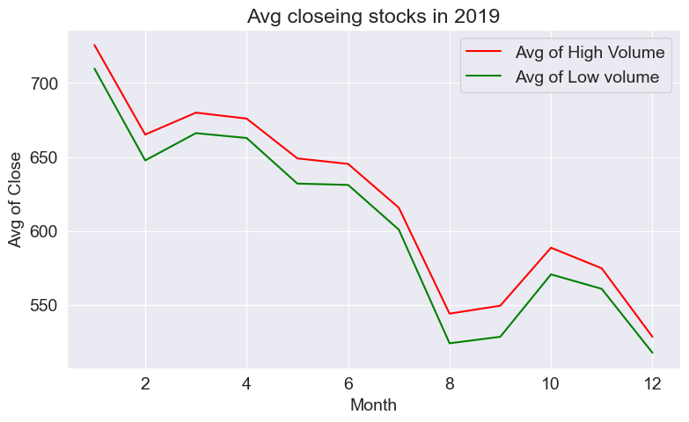
Mahindra & Mahindra Ltd.
Data Visualization

Slide 19
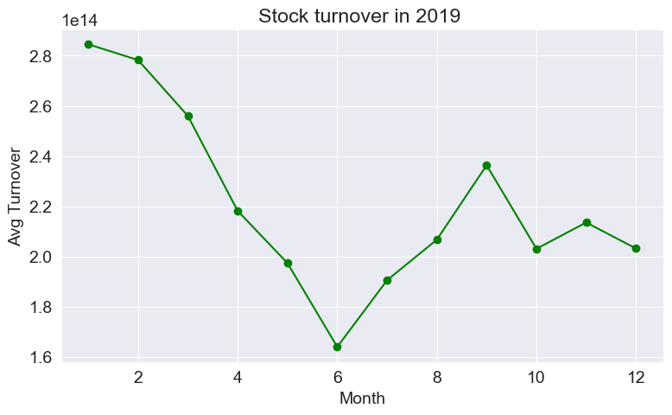
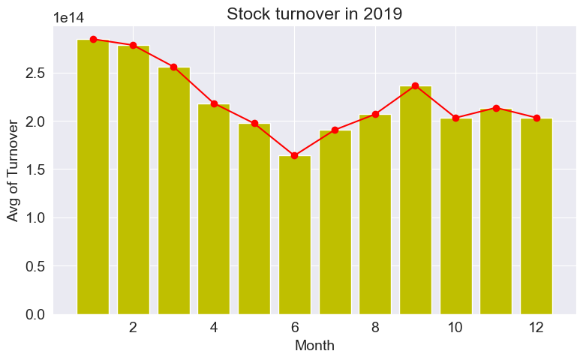
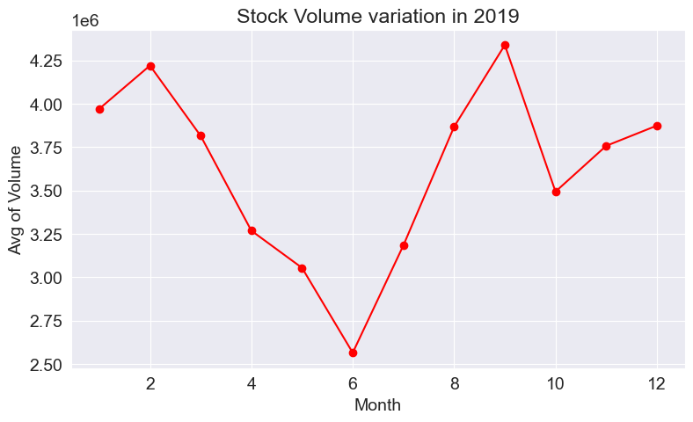
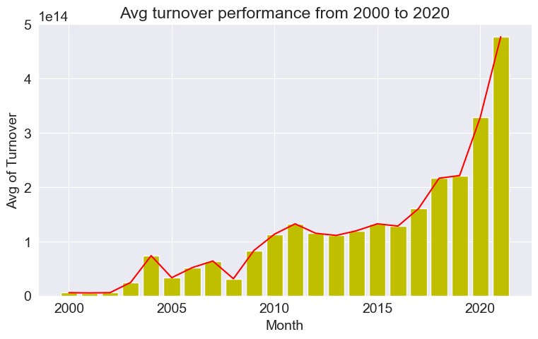

Slide 20
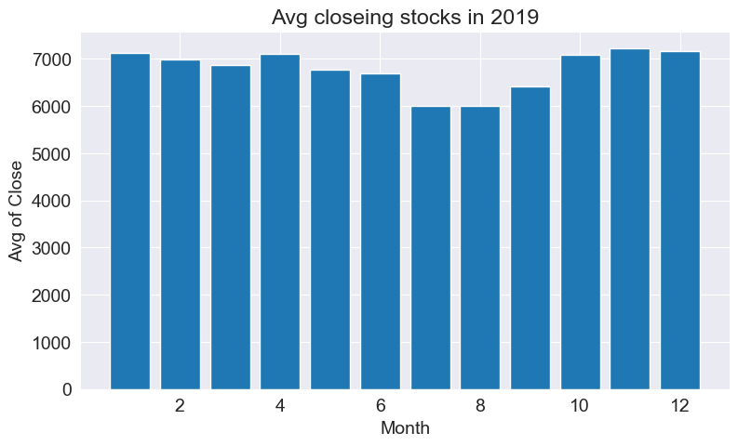
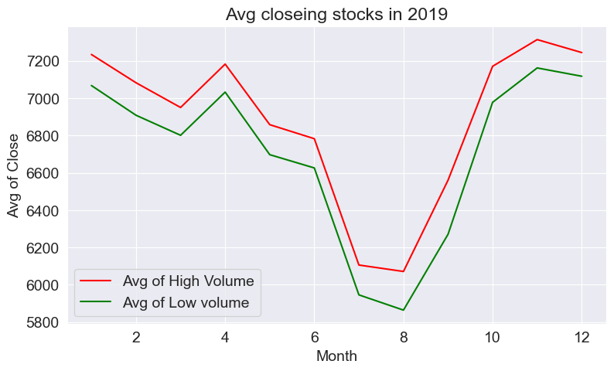
Maruti Suzuki India Ltd.
Data Visualization

Slide 21
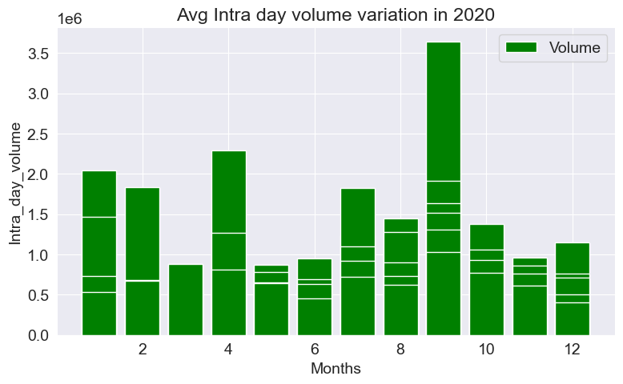
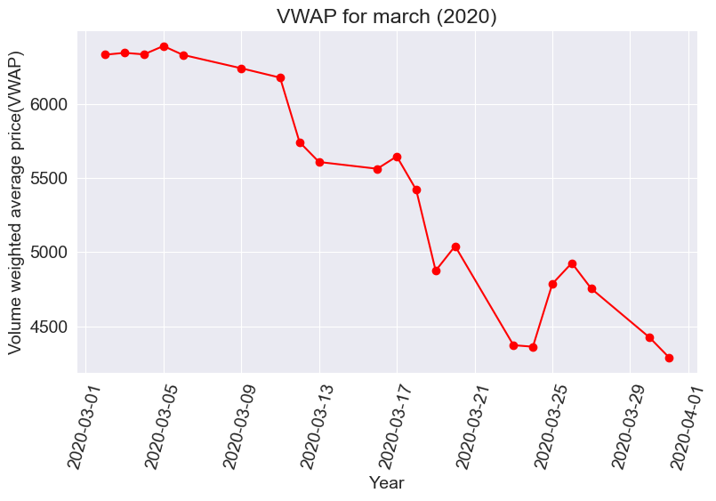
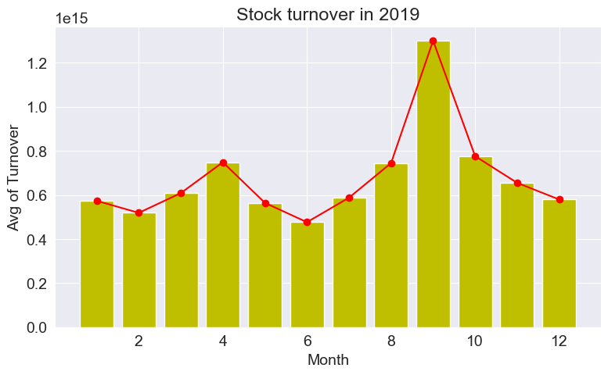
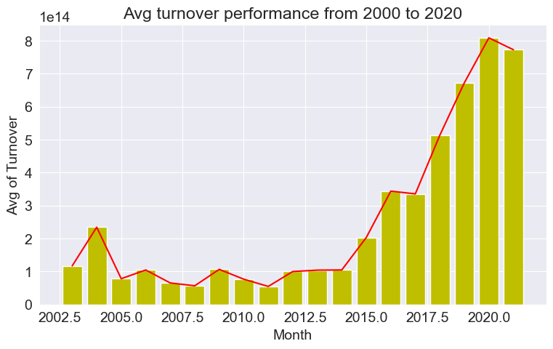

Slide 22
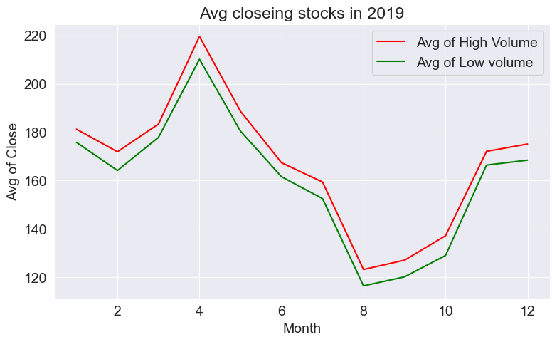
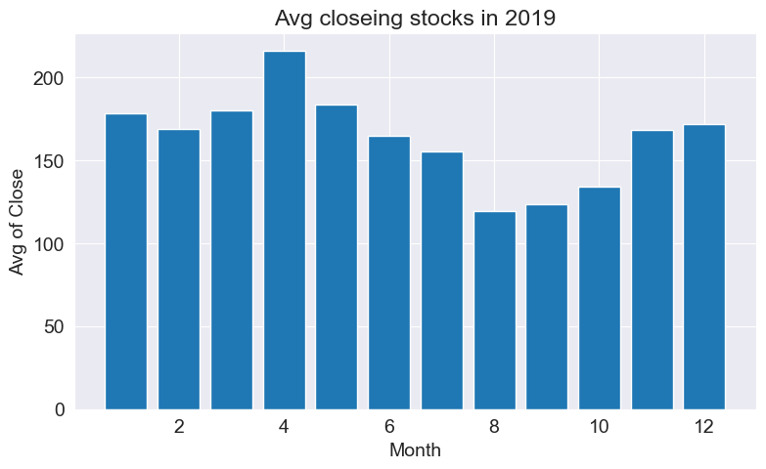
Tata Motors Limited.
Data Visualization

Slide 23
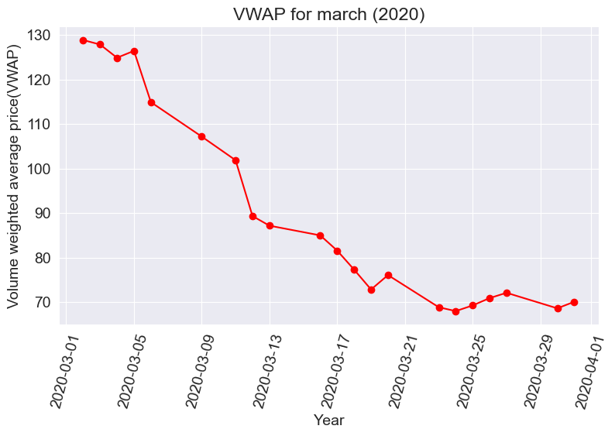
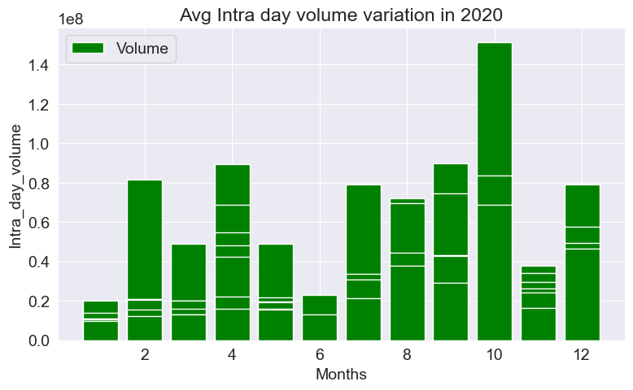
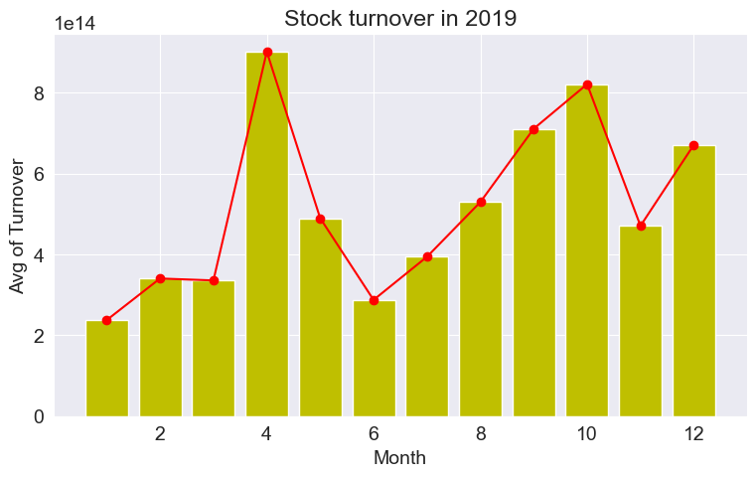
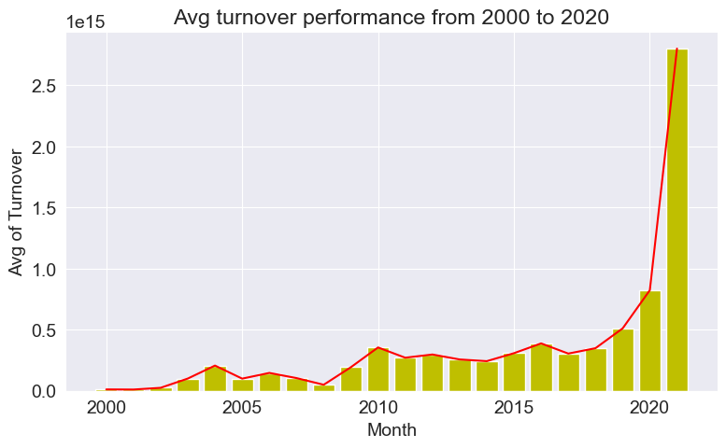

Slide 24
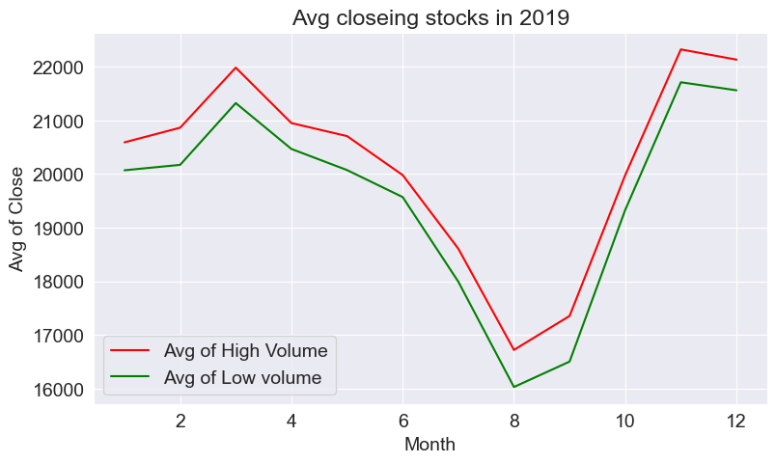
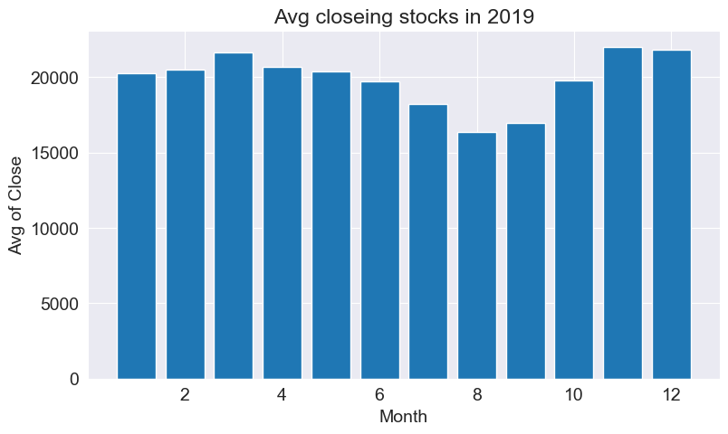
Eicher Motors Limited.
Data Visualization

Slide 25
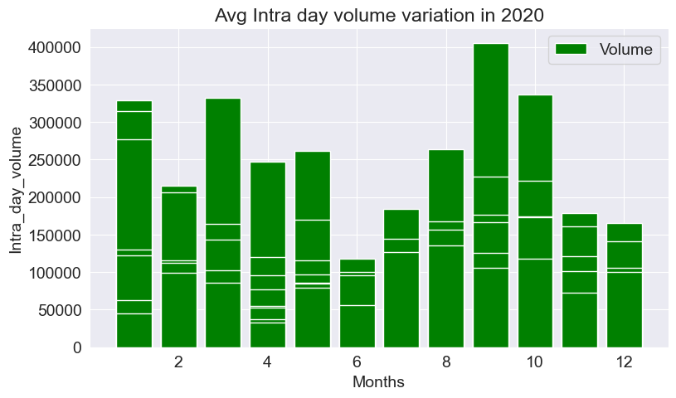
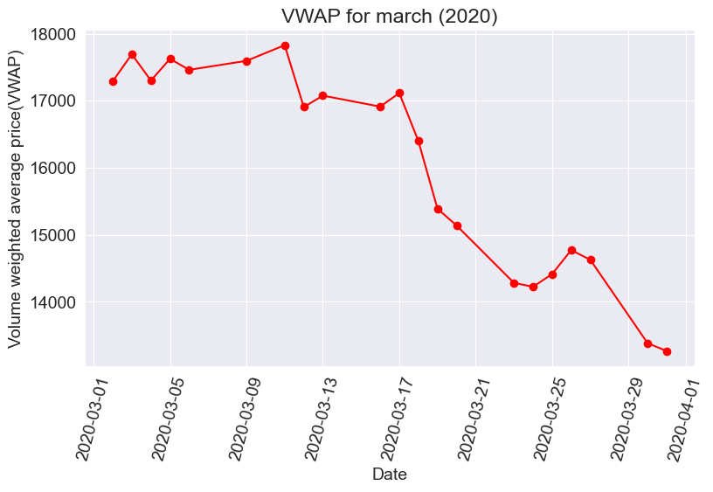
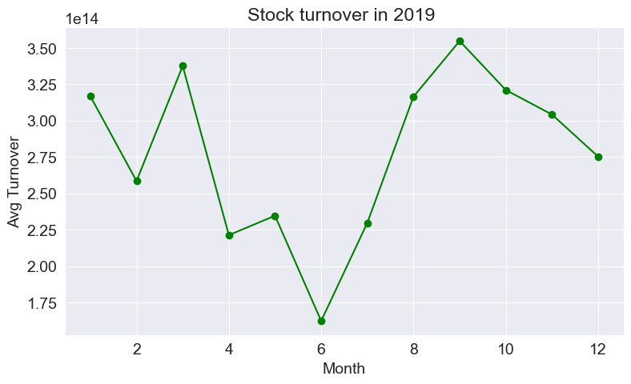
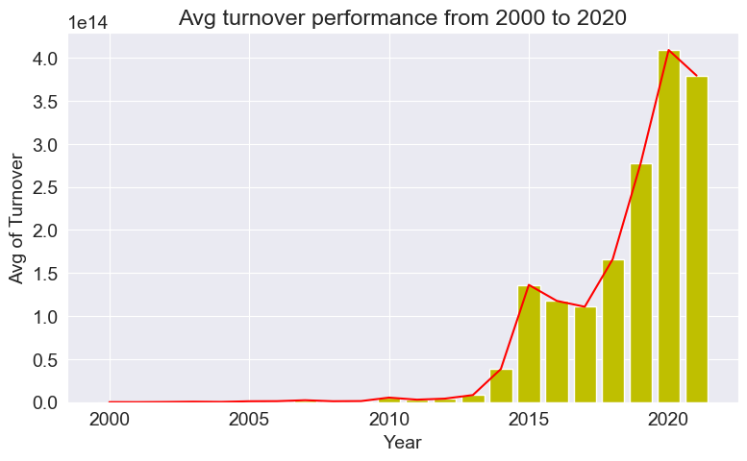

Slide 26
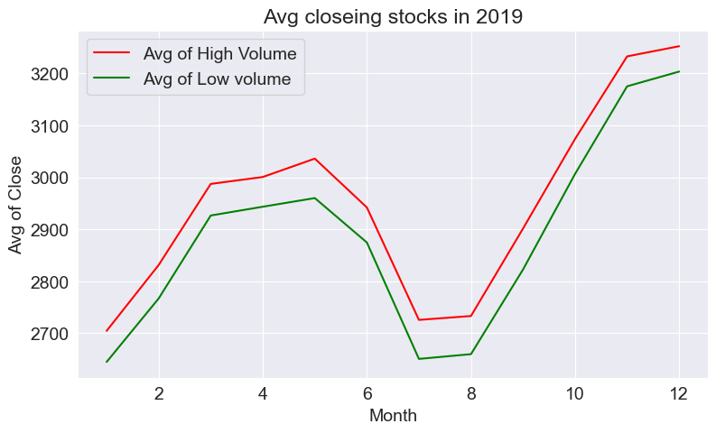
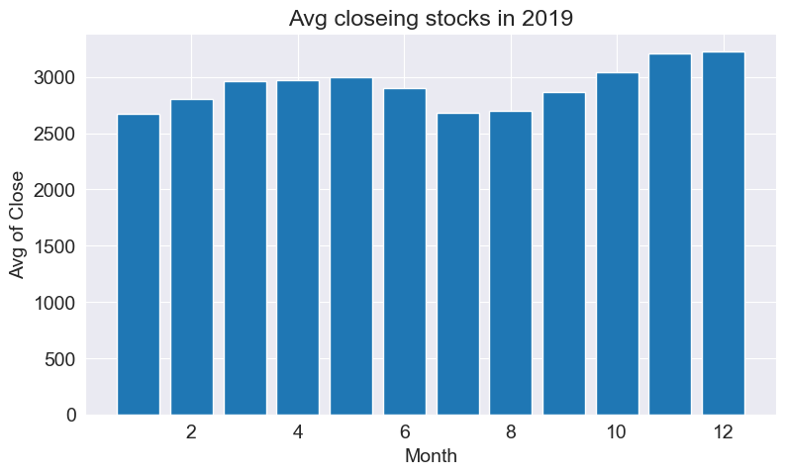
Bajaj Auto Limited.
Data Visualization

Slide 27
